Slide 1
Entrance management system
Team members
Arjun Chettri[THA07507]
Niraj Duwal[THA075028]
Suraj Agrahari[THA075043]
Supervisor
Er. Rama Bastola
Department of Electronics and Computer Engineering
Institute of Engineering, Thapathali Campus
March 12, 2019

Slide 2
Presentation outlines
Motivation
Objectives
Introduction
Methodology
Demo with sample data
Conclusion and Further works
References

Slide 3
Motivation
Will to make something different.
IOE entrance examination.
Contribution to society.
Learn with fun.
Systematic management in small scale.

Slide 4
Objective
To stores the data of candidate and their validity for entrance.
To select the qualified candidate for the universities, college and job.
To minimize the error and corruption in selection process
To maximize the comfort, accuracy and speed to publish the result.

Slide 5
Introduction
Background and central idea of project.
Problem faced
Project feature
Feasibility analysis
System requirement
Software requirement
Hardware requirement

Slide 6
Methodology
Main screen.
Form for student.
Modify.
Entrance examination.
Display student record.
Search student record.
Rank of student.

Slide 7
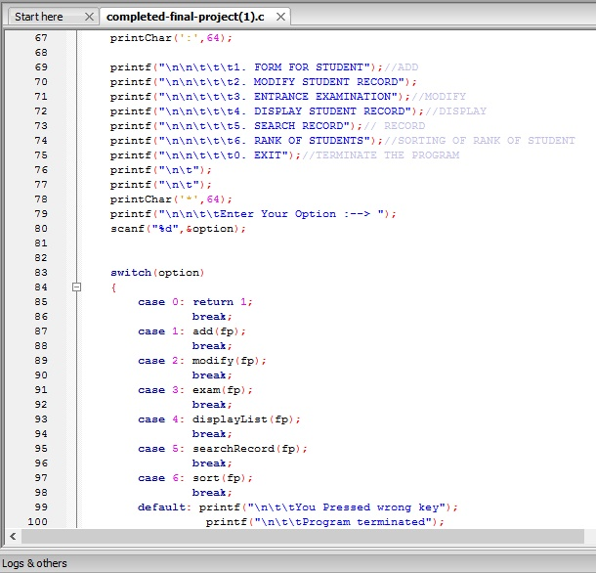
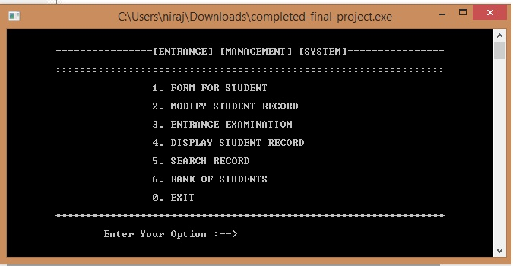
Main Screen
To choose the different options
Source code
Output

Slide 8
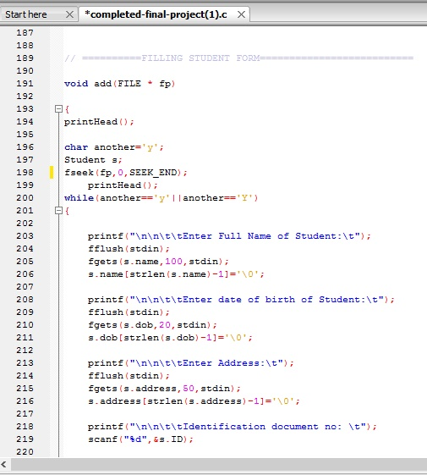
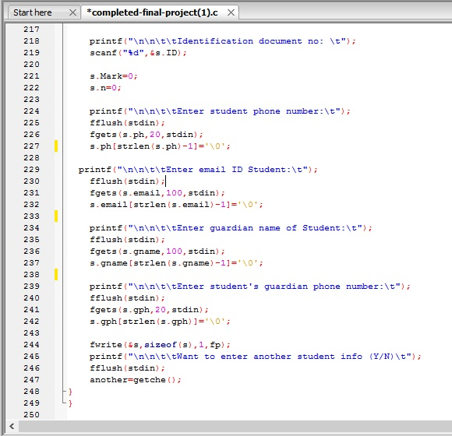
Form for Student
Fill full details of student as program asked
Source Code

Slide 9
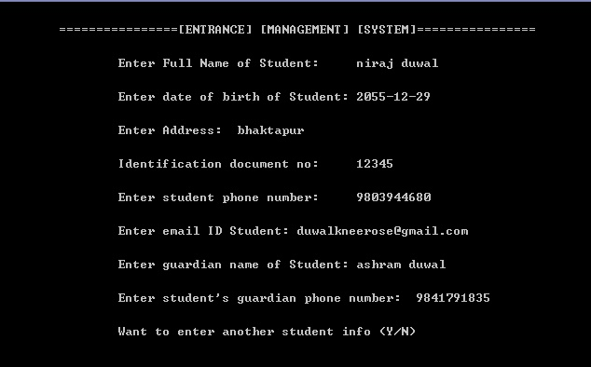
Output

Slide 10
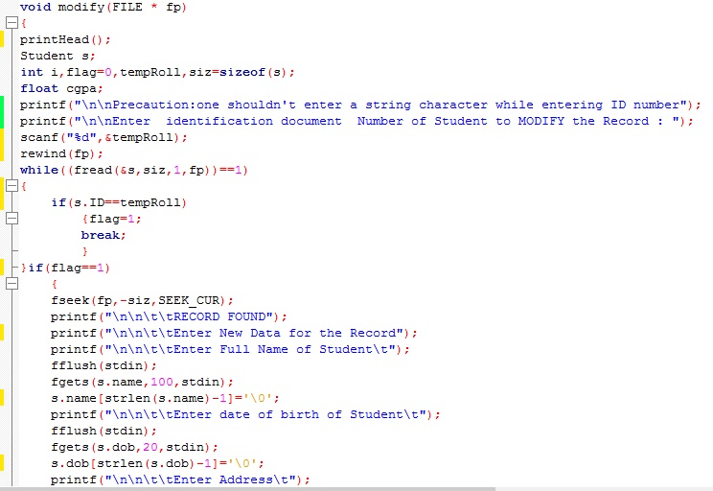
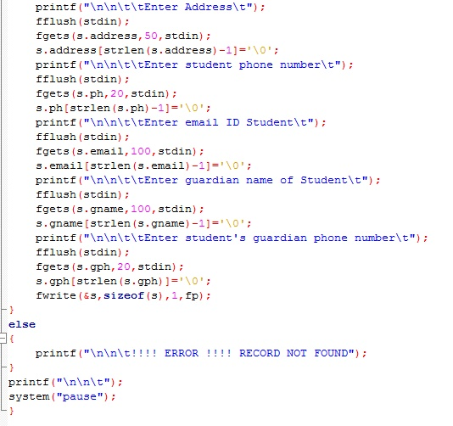
Modify
To modify the student details
Source code

Slide 11
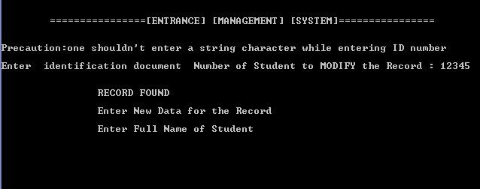
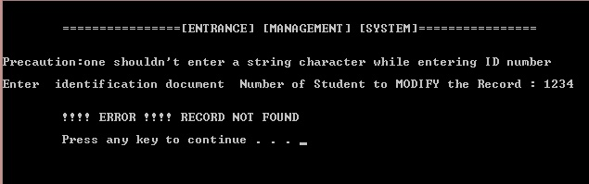
Output
If record is found
If record is not found

Slide 12
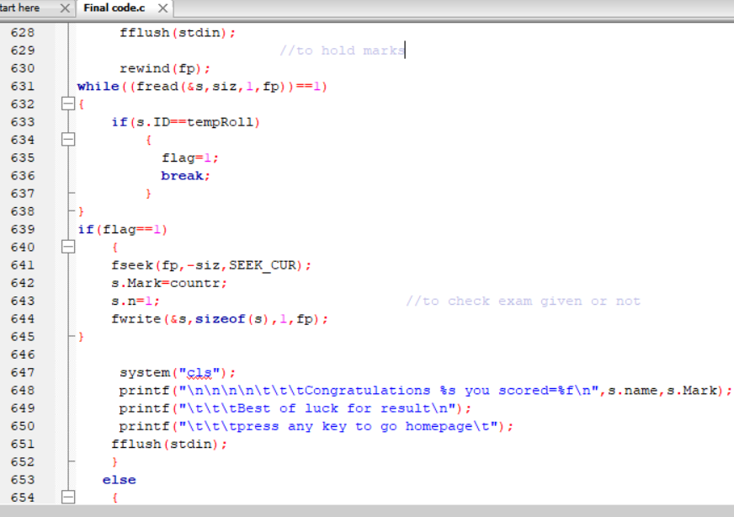
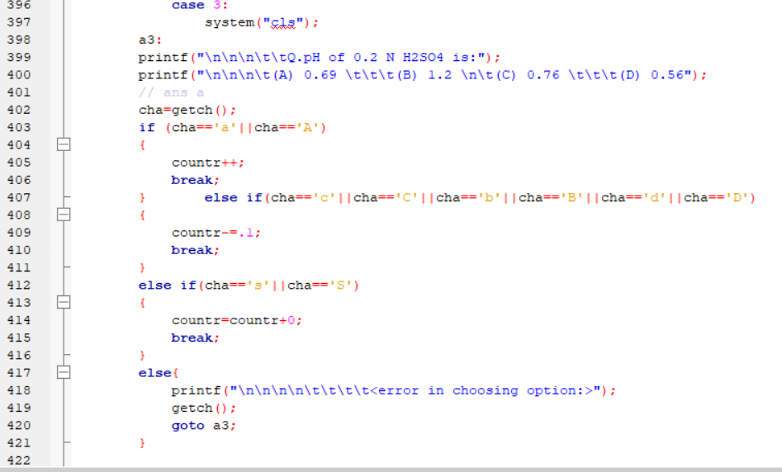
Entrance examination
Have to enter identification number to take exam
Source code
Code for question
Code for result display

Slide 13
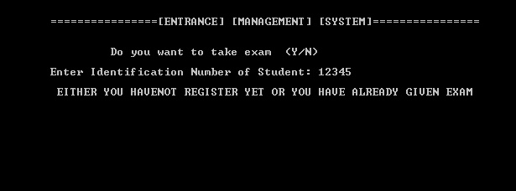
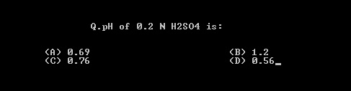
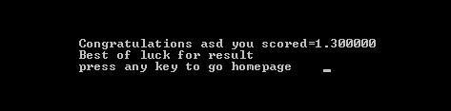
Output
If student already attempt exam
Question pattern and final display

Slide 14
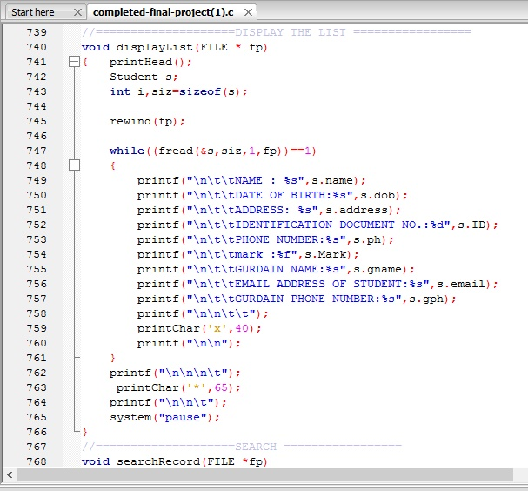
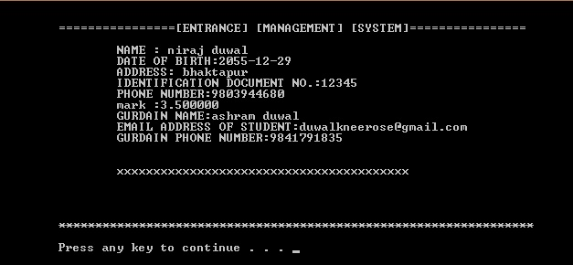
Display student record
To display the student details
Source Code
Output

Slide 15
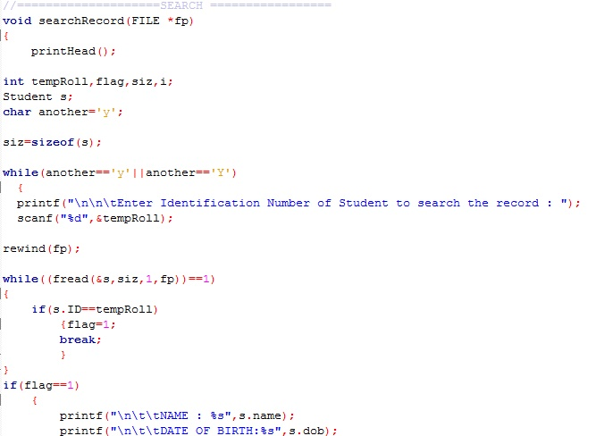
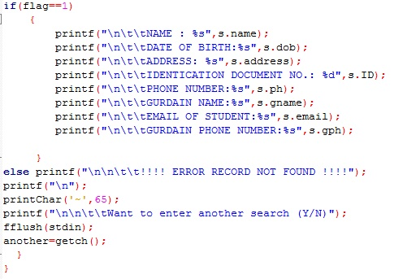
Search Record
To check the student details via identification number
Source code

Slide 16
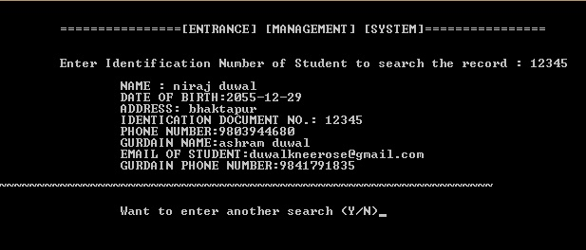
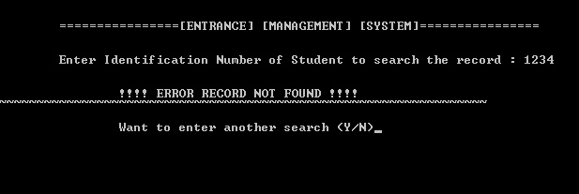
Output
If identification number is matched
If identification number is not matched

Slide 17
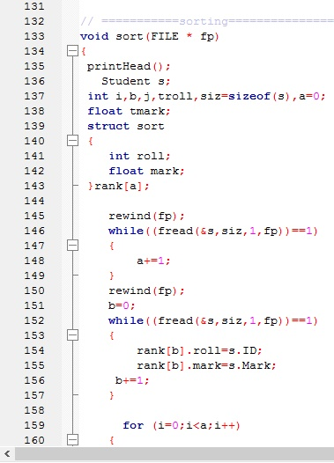
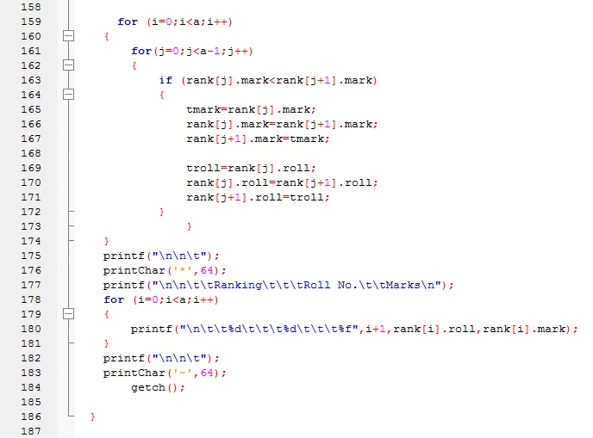
Rank of Student
To display the rank of student
Source Code

Slide 18
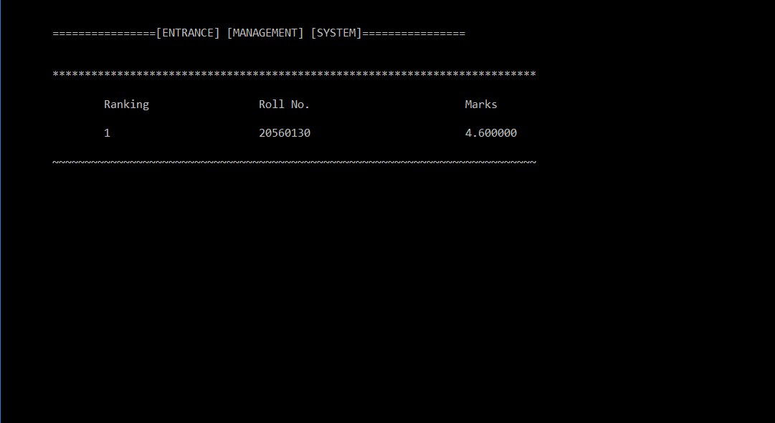
Output

Slide 19
Demo with sample

Slide 20
Conclusion
Introduction of automation in MCQ examination.
Rankwise sorting along with their validity to respective field.
Processing information will be faster.
Data will be secured.

Slide 21
Further works
Addition of number of question.
Introduction of automatic clock.
Introduction of automatic submission technique.
Test in applicable field.
Set a LAN and evaluate the whole data.

Slide 22
Reference
Braian w. Kernighan and dennis M.ritchie, “The C Programming Language”, Second Edition.
Robort lafore , “ The waite groups C programming using turbo C++” second Edition
Yashavant kanetkar , “ let us C” ,seventh edition
AI Kelly and Ira pohl, “ A Book on C”, fourth edition
http://www.wikipedia.org /wiki/literature review, 2019 jan 26
http://www.ioe.edu.np
Daya Sagar Baral, Duwakar Baral, Sharad Kumar Ghumire, “The Secrets of C Programming Language”

Slide 23
Thanks for your
precious
time

